Slide 1

PREOWNED CARS SELLING WEBSITE
MINI PROJECT
UNDER THE GUIDENCE OF
Prof.G.S.KARTHICK.,M.Sc.,NET.,DST-Fellow.,(Ph.D)., ASSISTANT PROFESSOR, DEPARTMENT OF SOFTWARE SYSTEMS, PSG COLLEGE OF ARTS & SCIENCE, COIMBATORE-641014.
PRESENTED BY
Mr G .SANJAI (20MSS038)
DEPARTMENT OF SOFTWARE SYSTEMS,
PSG COLLEGE OF ARTS & SCIENCE,
COIMBATORE-641014

Slide 2
AGENDA
ABSTRACT
EXISTING SYSTEM
PROPOSED SYSTEM
HARDWARE AND SOFTWARE SPECIFICATION
MODULES OF THE PROJECT
DATAFLOW DIAGRAM
E-R DIAGRAM
TABLE DESIGN
UI DESIGN
SCOPE FOR FUTURE ENHANCEMENT
CONCLUSION

Slide 3
ABSTRACT
Preowned Cars Selling website is a software developed to buy cars online.
The Project “PREOWNED CARS SELLING WEBSITE” deals with the various level of project development
This website is for buyers who can have a wide variety of choices to choose a car for their needs a best price and quality.
It is developed to reduce fake details of cars. They can have cars in wide range according to the condition and model of the cars.

Slide 4
The interface of the project work entitled “PREOWNED CARS SELLING WEBSITE”
It is developed using PHP, HTML, CSS, JavaScript as FrontEnd and MySQL as BackEnd

Slide 5
EXISTING SYSTEM
Difficult to find cars according to our needs.
Only limited number of cars would be there for consideration.
The existing system was not much interactive and very slow.
The existing system doesn’t provide much information about cars. Only, the basic details
were available.

Slide 6
PROPOSED SYSTEM
Easy to find cars for our needs.
More User-Interactive.
Better User-Interface.
Genuine details were only posted.
Easy to find records.

Slide 7
HARDWARE SPECIFICATION
COMPONENTS | REQUIREMENTS
PROCESSOR | INTEL CORE i5
SYSTEM RAM | 4 GB AND ABOVE
HARD DISK DRIVE | 256 SSD AND ABOVE

Slide 8
SOFTWARE SPECIFICATION
COMPONENTS | REQUIREMENTS
FRONT-END | JAVASCRIPT,HTML,CSS AND PHP
BACK-END | MYSQL
OPERATING SYSTEM | WINDOWS 7 AND ABOVE

Slide 9
MODULE:
Admin Module:
Admin who can manage everything on the website. Admin can log in through the login page.
Company Info:
The Company Info module allows the admin to add, update and delete the Company information on the website.

Slide 10
Enquiry:
In this module, the admin can answer to the unanswered enquiries and can also see the answered enquiries in the admin dashboard.
USER MODULE:
User can visit the webpage and see the cars.
They can enquiry about the cars if they are interested

Slide 11
DATA FLOW DIAGRAM
LEVEL 0
Admin
Login
Admin_db

Slide 12
LEVEL 1
Admin
Add/edit cars
Cars
Add/edit company
Company
Update/
search enquiries
Enquiry
Edit contact us
Contact us
Edit about us
About us

Slide 13
LEVEL 2
User
Enquires
Enquiry

Slide 14
ER DIADGRAM
UserName
AdminName
MobileNumber
Email
id
Passenger
Website
Has
Admin
AdminRegadate
Visit
Id
id
CompanyName
Company
Add
CarName
User
CarType
CompanyRegdate
CarCompany
Can
Belong to
CarBodyColor
cars
CarBodytype
Enquiry
Belong to
Car Model
id
Car price
Email
Car number
Last update
Fuel type
Mobile number
No Of Owners
Max power
Message
Milage
Enquiry date
Reg year
Air condition
Fuel capacity
Car ABS
Status
Air bags
Car description

Slide 15
DATABASE DESIGN
ADMIN TABLE
S.NO | Name | Type | Null | Default
1 | ID | Int(10) | No | None
2 | AdminName | Varchar(45) | Yes | NULL
3 | MobileNumber | bigint(10) | Yes | NULL
4 | Email | Varchar(120) | Yes | NULL
5 | Password | Varchar(120) | Yes | NULL

Slide 16
COMPANY TABLE:
S.NO | Name | Type | Null | Default
1 | ID | Int(10) | No | None
2 | CompanyName | Varchar(120) | Yes | NULL

Slide 17
ENQUIRY TABLE:
S.NO | Name | Type | Null | Default
1 | ID | Int(10) | No | None
2 | Email | Varchar(250) | Yes | NULL
3 | MobileNumber | Bigint(10) | Yes | NULL
4 | Message | Varchar(250) | Yes | NULL
5 | EnquiryDate | Timestamp | Yes | NULL
6 | Status | Varchar(10) | No | None

Slide 18
Car table
S.NO | Name | Type | Null | Default
1 | ID | Int(10) | No | Done
2 | Car Name | Varchar(50) | Yes | Null
3 | Car Type | Varchar(50) | Yes | Null
4 | Car Company | Varchar(50) | Yes | Null
5 | Car Bodycolor | Varchar(50) | No | Null
6 | Car Body type | Varchar(50) | No | Null
7 | Car Model | Varchar(120) | No | Null
8 | Car price | Varchar(120) | Yes | Null
9 | Car number | Varchar(120) | Yes | Null
10 | Fuel type | Varchar(120) | Yes | Null

Slide 19
11 | Max power | Varchar(120) | Yes | Null
12 | Millage | Varchar(20) | Yes | Null
13 | Air condition | Varchar(20) | Yes | Null
14 | Car ABS | Varchar(20) | Yes | Null
15 | Airbags | Varchar(20) | Yes | Null
16 | Car description | Varchar(120) | Yes | Null
17 | Fuel capacity | Int(50) | Yes | Null
18 | Reg year | Int(10) | Yes | Null
19 | No of owner | Int(10) | Yes | Null
20 | Last update | Timestamp | Yes | Current_ timestamp

Slide 20
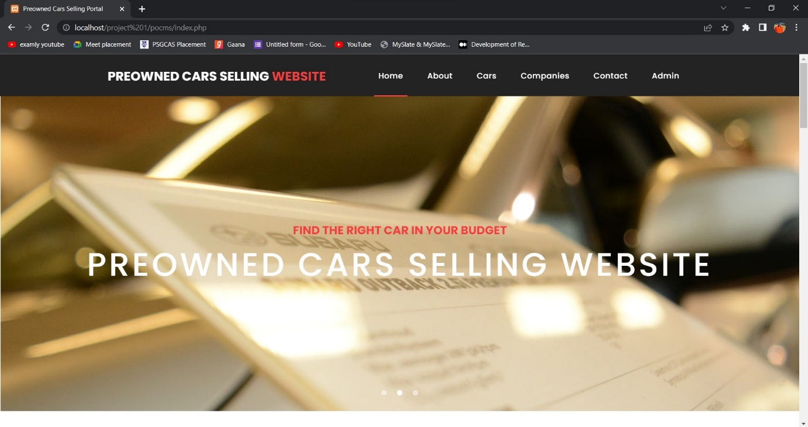
HOME PAGE

Slide 21
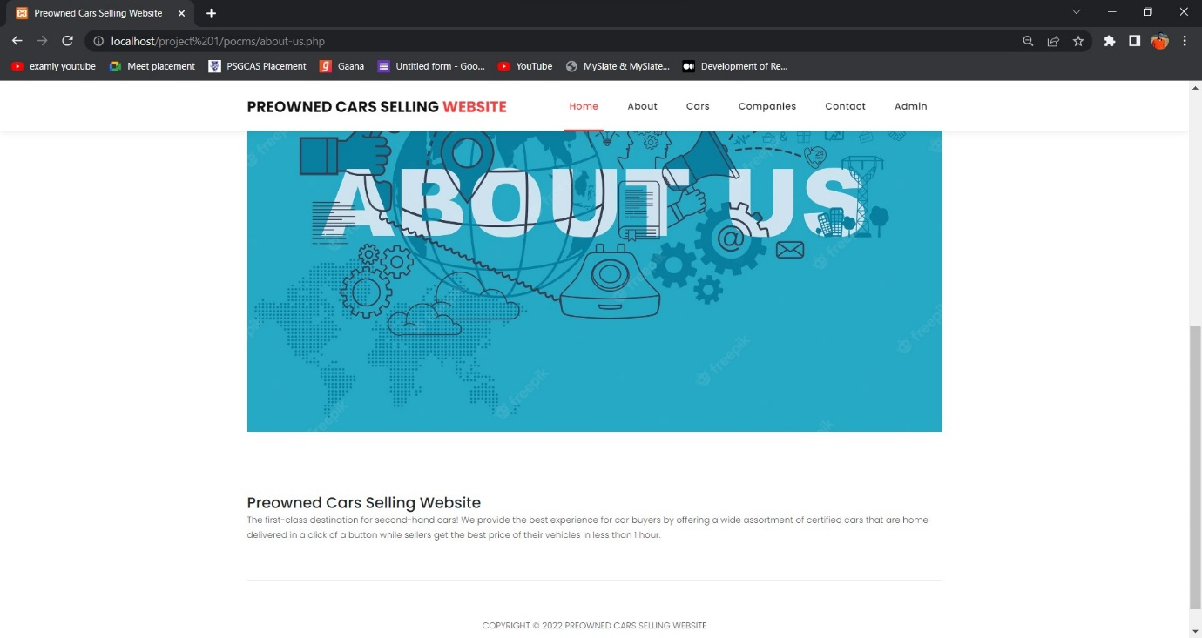
ABOUT PAGE

Slide 22
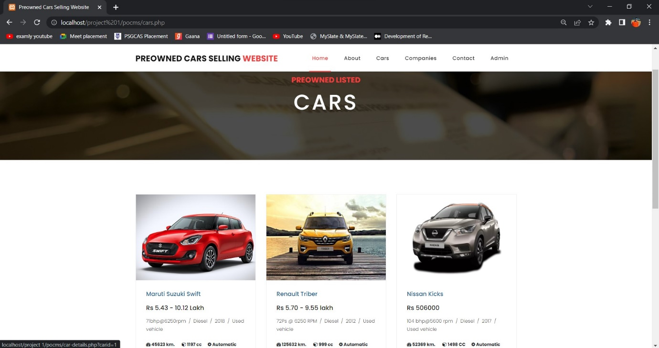
CARS PAGE

Slide 23
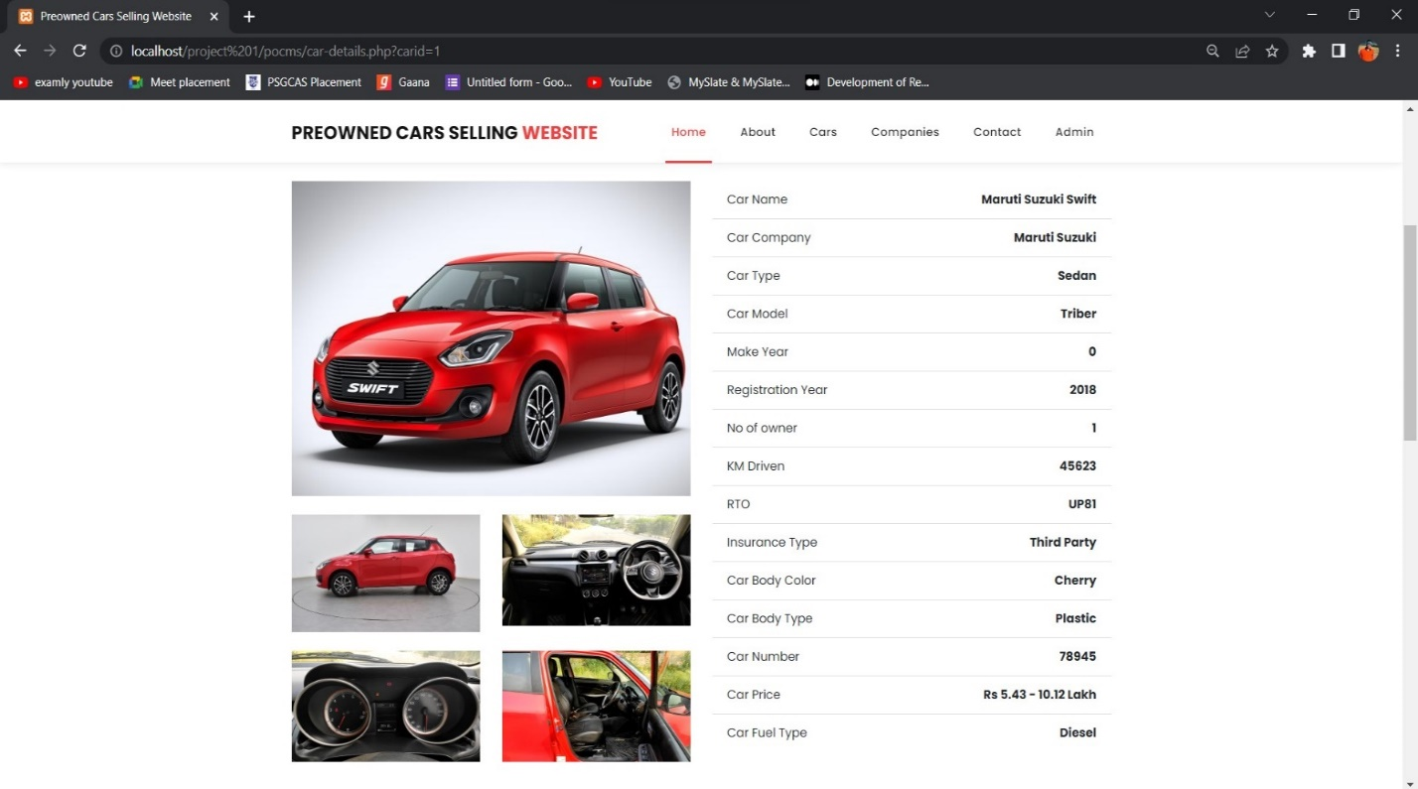
SPECIFIC CAR DETAILS

Slide 24
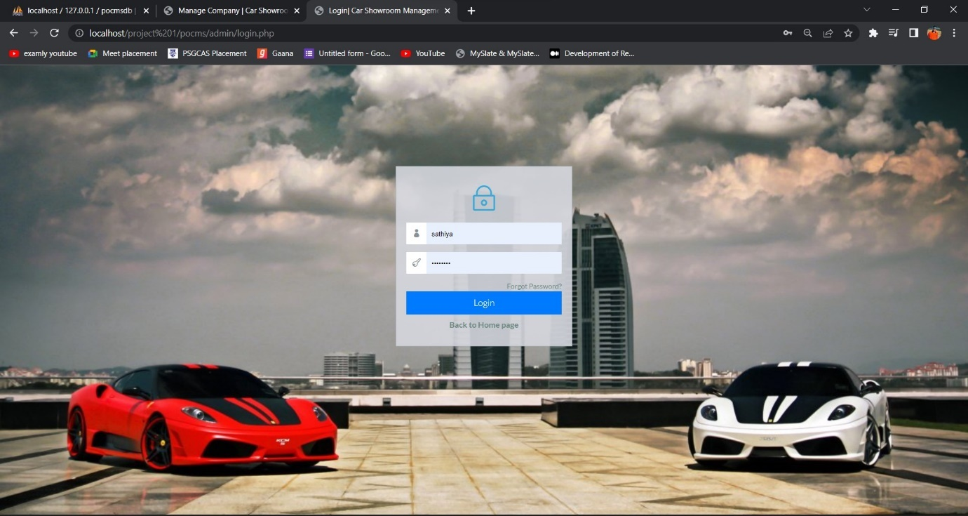
ADMIN LOGIN PAGE

Slide 25
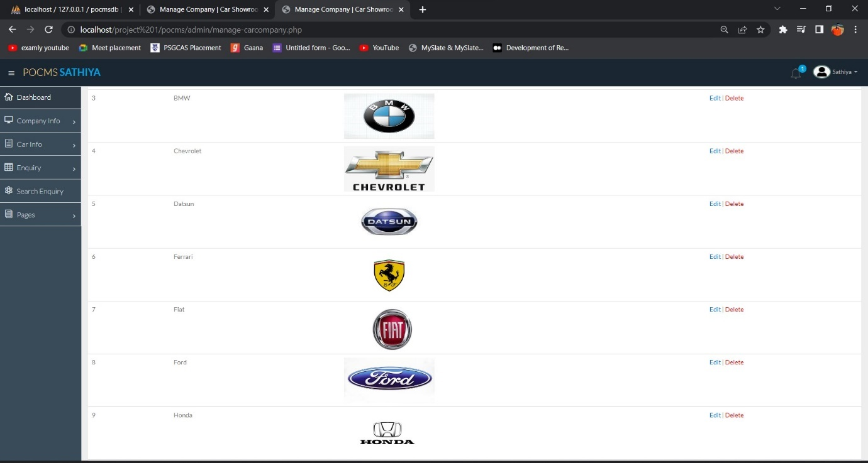
ADMIN MANAGE COMPANY INFO

Slide 26
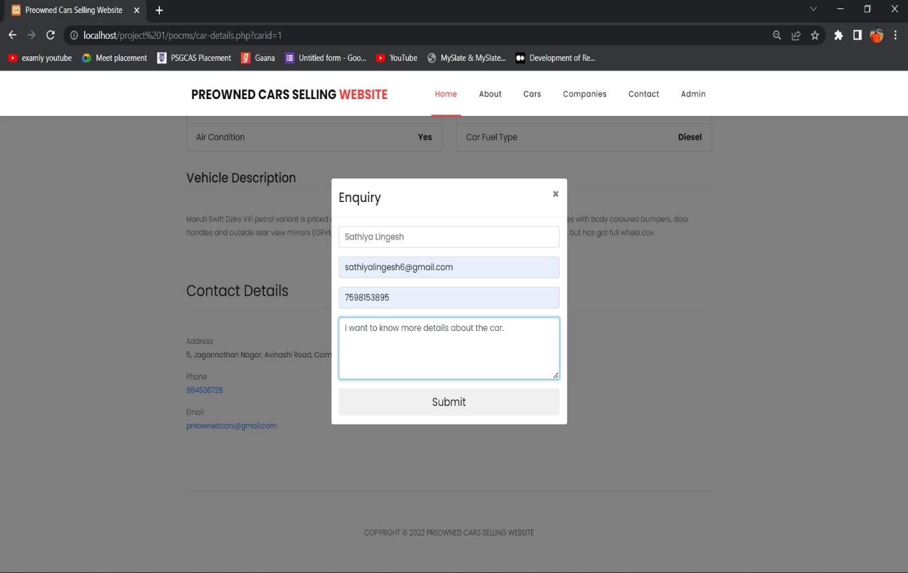
ENQUIRY PAGE

Slide 27
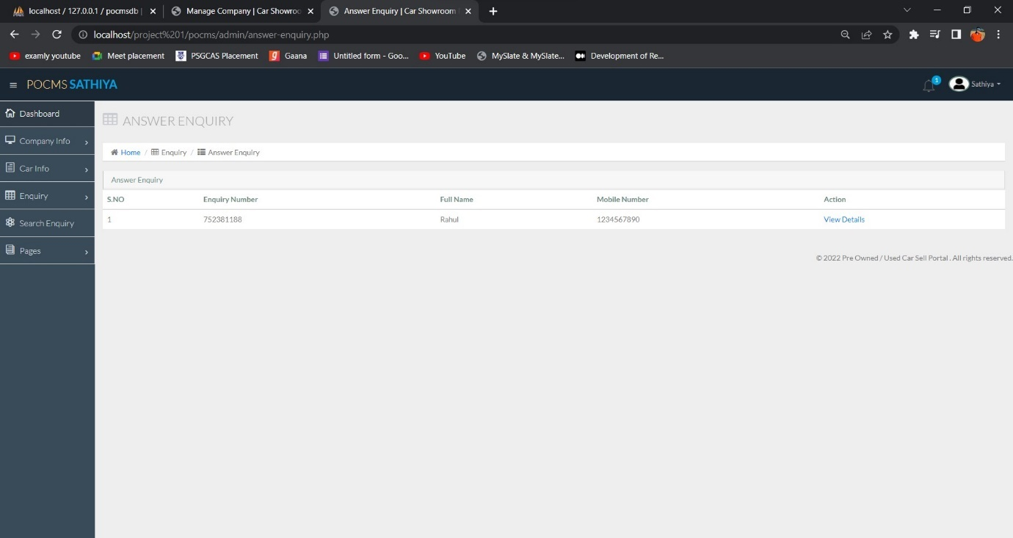
ADMIN ANSWERED ENQUIRY PAGE

Slide 28
SCOPE FOR FUTURE ENHANCEMENT
In, future we can develop as a mobile application which increases the reach. And also, we can add features like online request to sell their cars, send SMS or mail for confirmation as their enquiry is received to admin.
We can add features like online auction, online prediction of car price for sellers who wants to sell their car.

Slide 29
CONCLUTION
The project titled “Preowned Cars Selling Website” is to develop a website to buy cars in online.
This website can be used for both online and also in showrooms to show their cars so that customers can easily know what type of cars are available.
Customers can get a wide variety of cars to choose. Customers can also know the differences in process of car between different showrooms.
Now, customers can see all the details of the car through the website and can choose according to their needs like horsepower, engine performance, body type.

Slide 30
Customers can get the best price for their cars. The proposed system was much more interactive and user-friendly than before.
Information about the cars and companies were added by the admin.

Slide 31
THANK YOU

